Slide 1
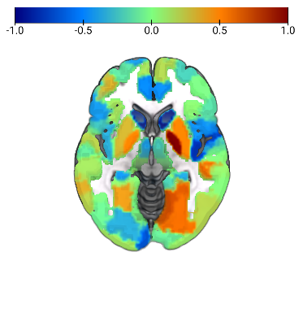
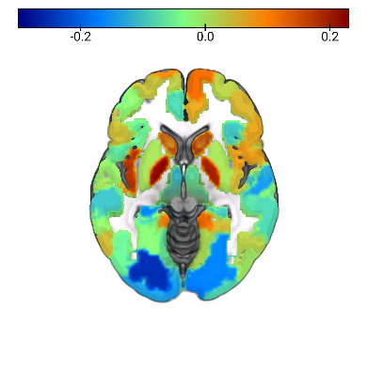
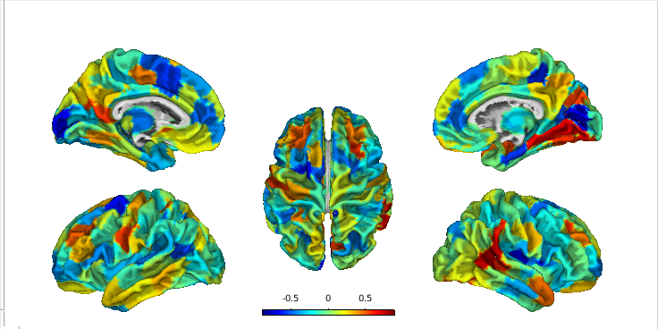
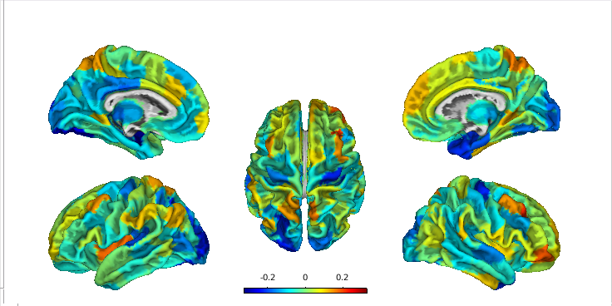
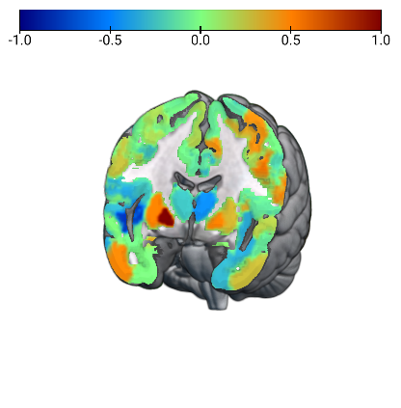
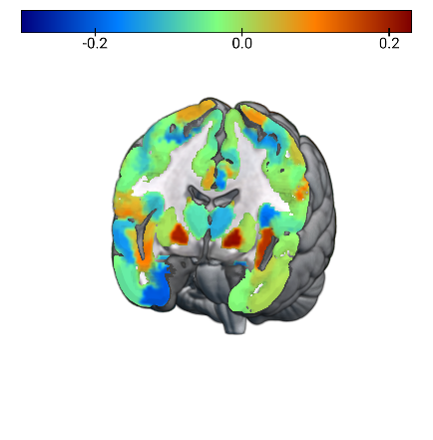
FDG-PET
MRI
Version 1
a)
b)
Hemisphere
Left
Right
Atlas (Network) Region
δ MRI
Visual
SomatoMotor
Temporal Parietal
Dorsal Attention
Salience/Ventral Attention
Control
Default
Limbic
Subcortical (Tian atlas)
c)
δ FDG-PET

Slide 2
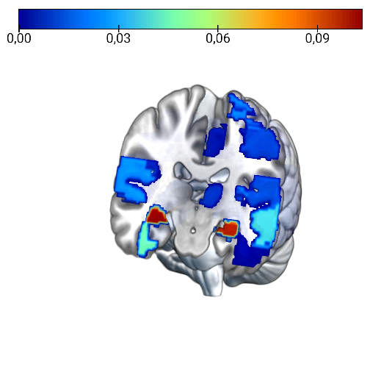
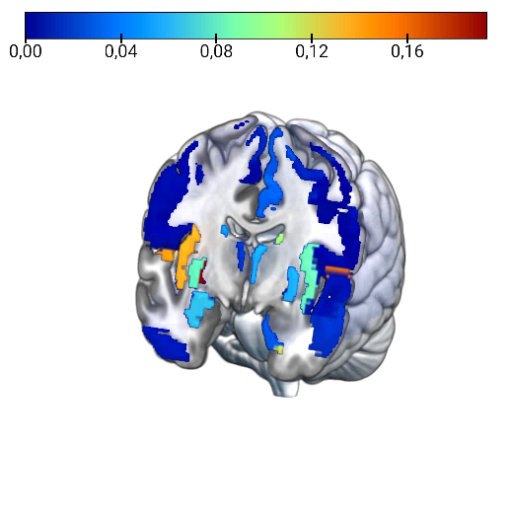


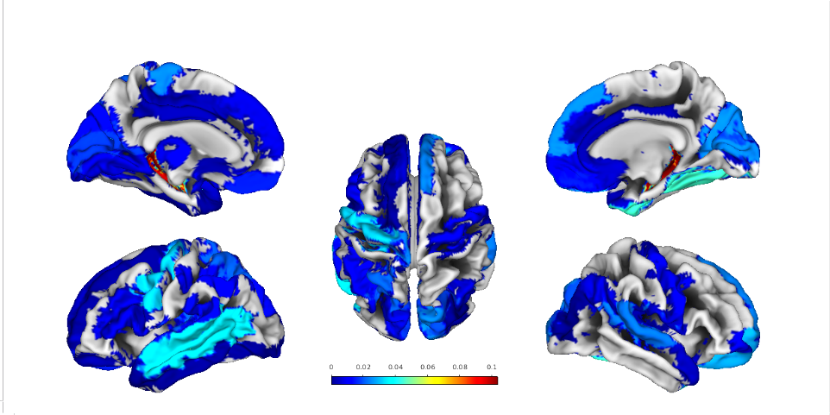
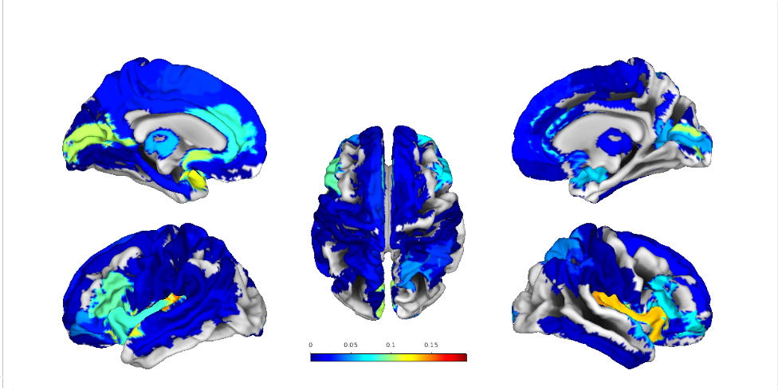

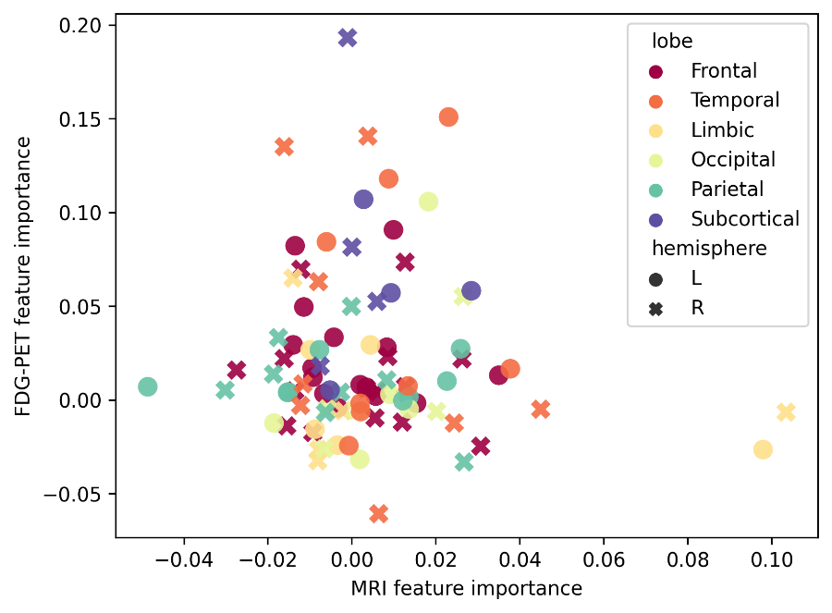
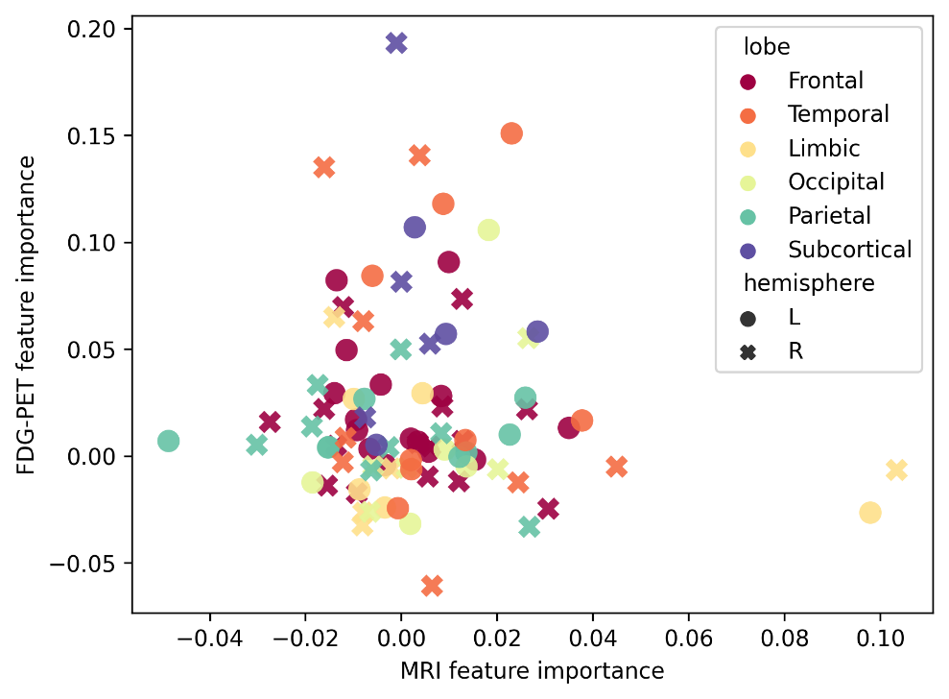
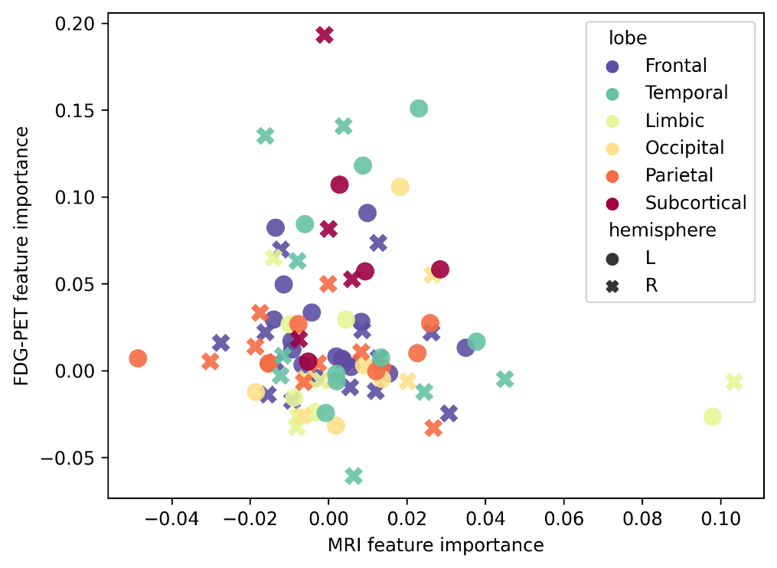
MRI
FDG-PET
a)
b)
GP (right)
Lobe
Frontal
Temporal
Limbic
Subcortical
Occipital
Parietal
Left
Right
Permutation importance FDG-PET
Hippocampus (right)
Hippocampus (left)
c)
Permutation importance MRI

Slide 3
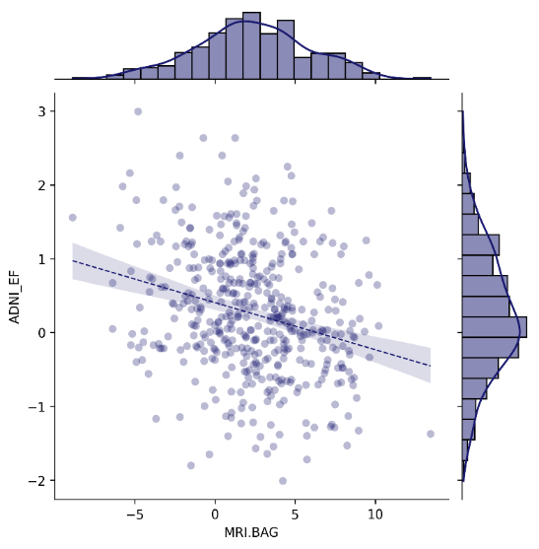
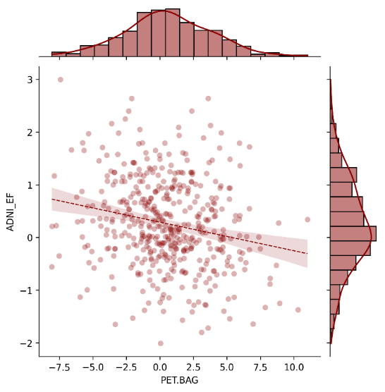
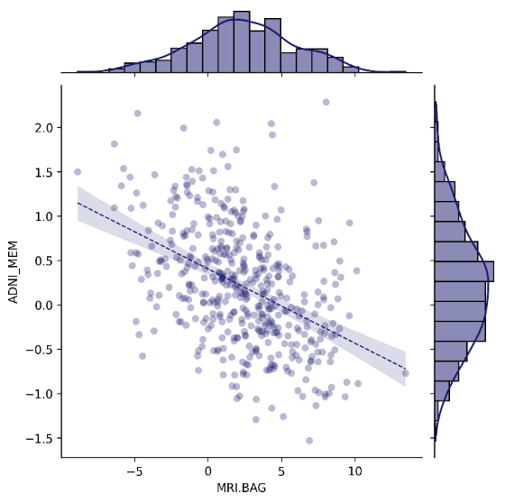
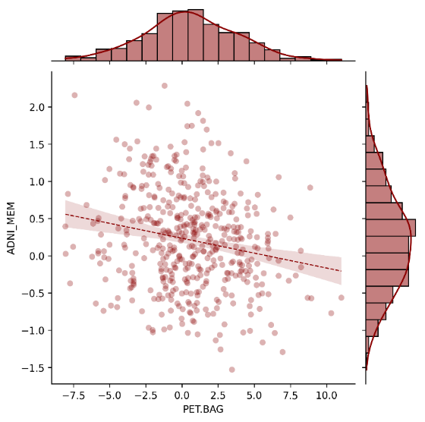
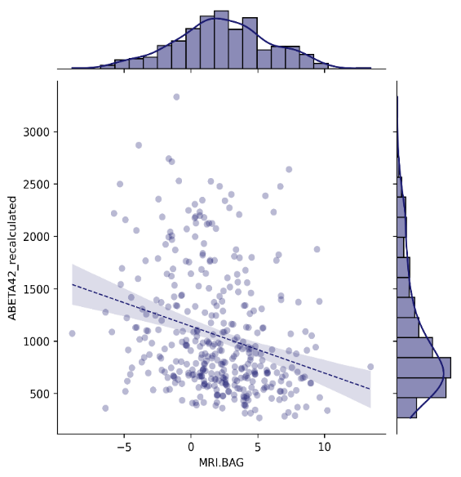
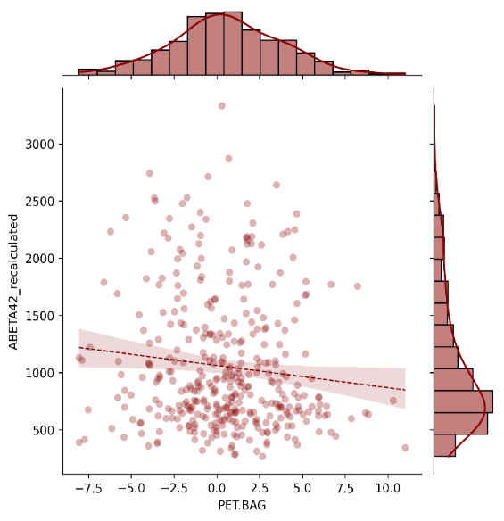
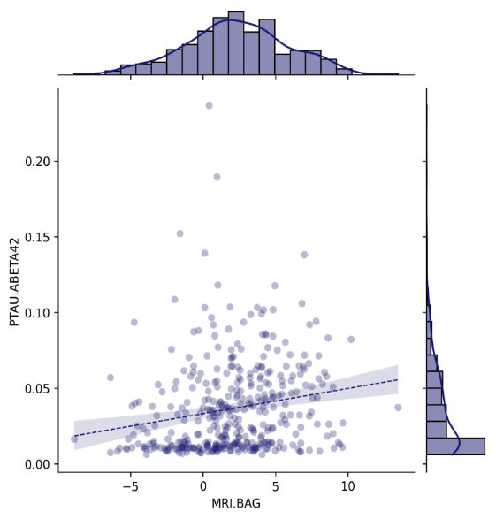
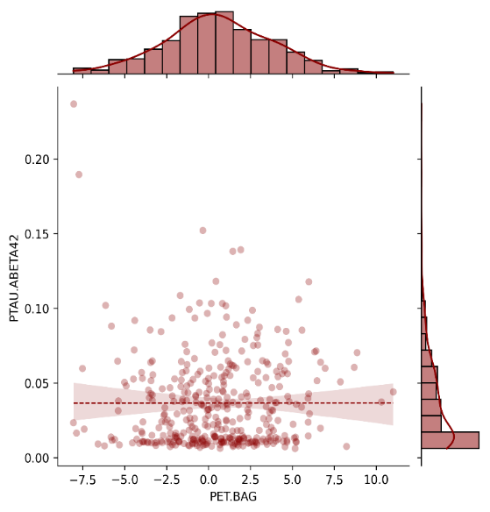
r = -.225, p < .001
r = -.238, p < .001
ADNI-EF
rho = -.397, p < .001
rho = -.179, p < .001
ADNI-MEM
a)
rho = -.230, p < .001
rho = -.126, p = .015
CSF Aβ₁₋₄₂ [pg/ml]
rho = .200, p < .001
rho = .100, p = .052
p-Tau₁₈₁/CSF Aβ₁₋₄₂ ratio
b)
MRI BAG [years]
FDG-PET BAG [years]

Slide 4
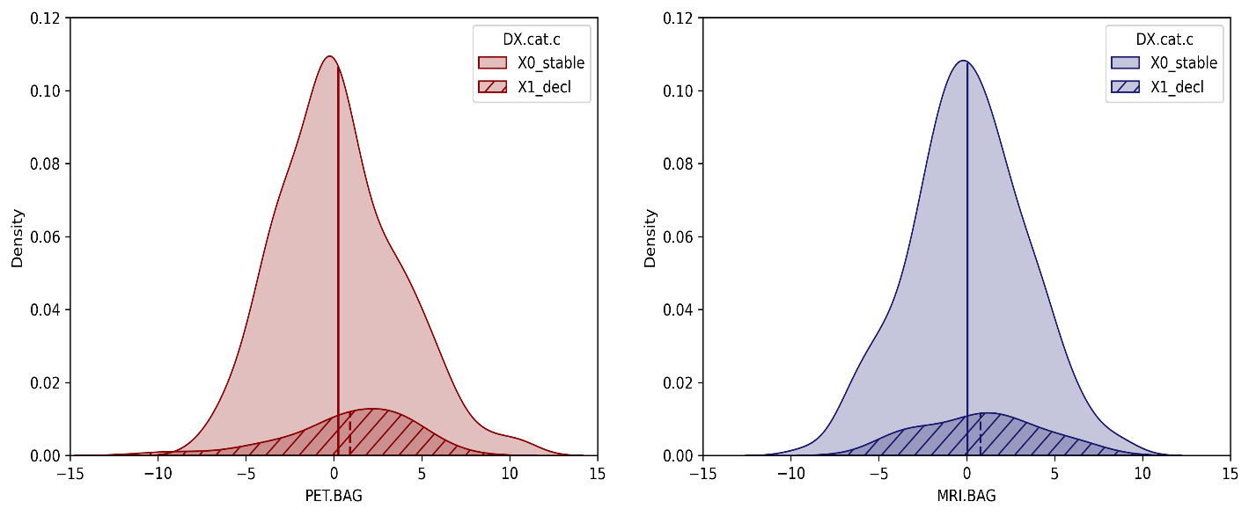

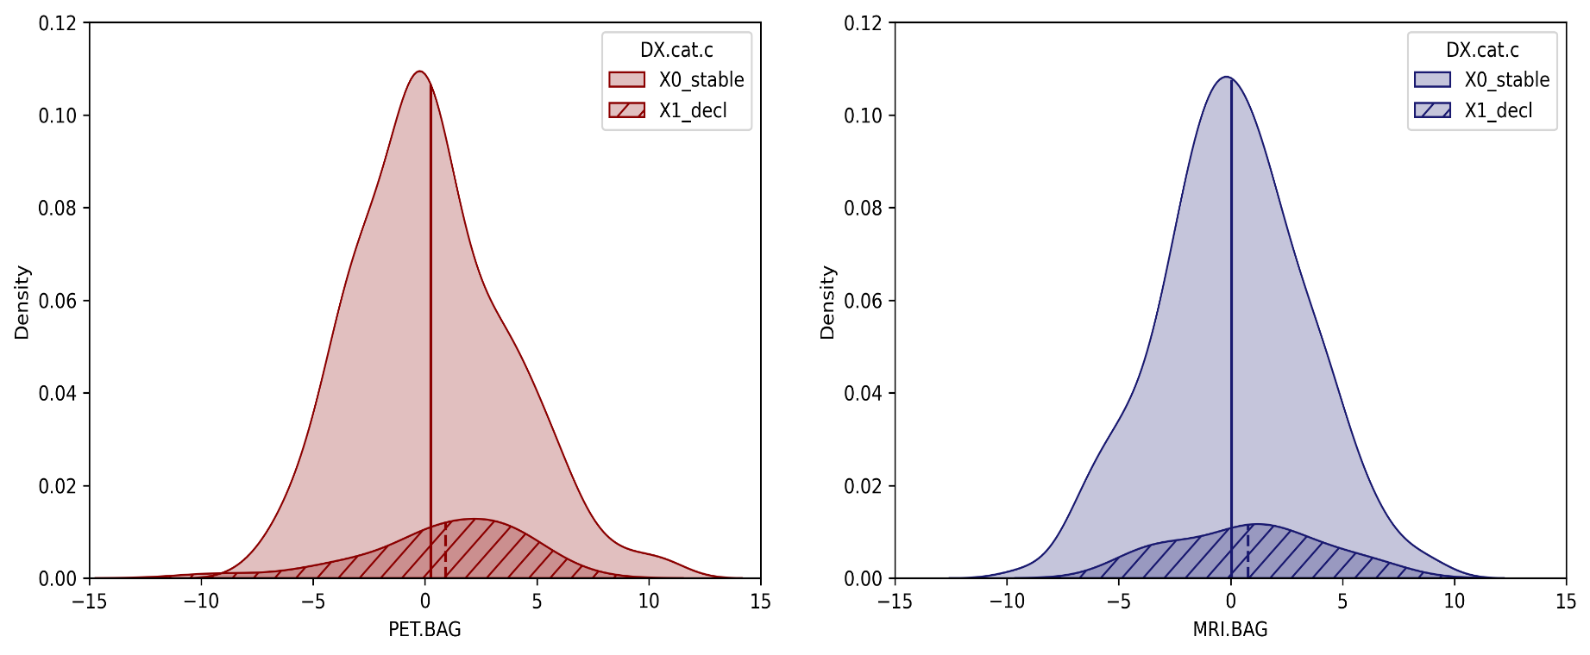
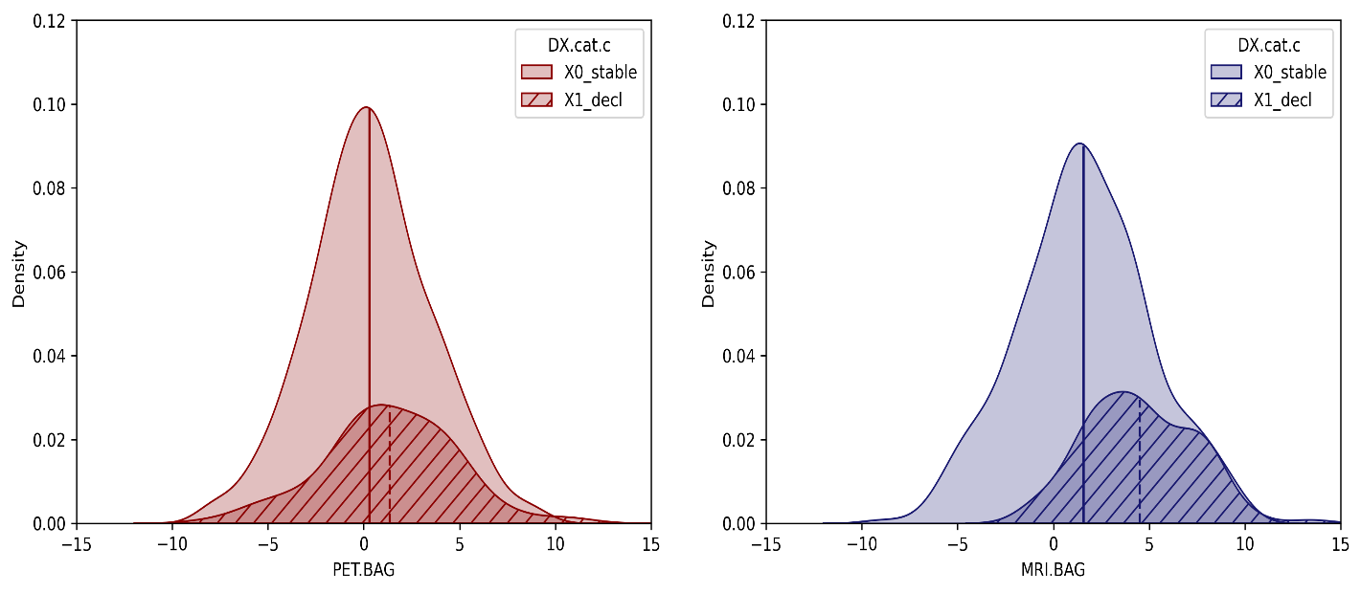
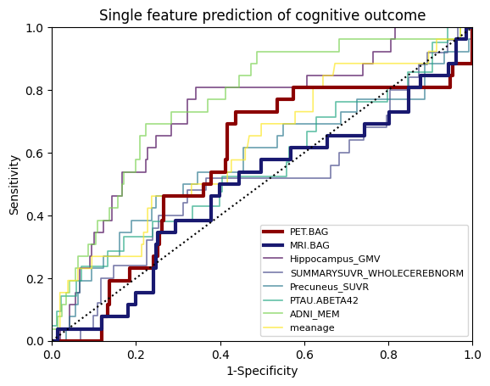
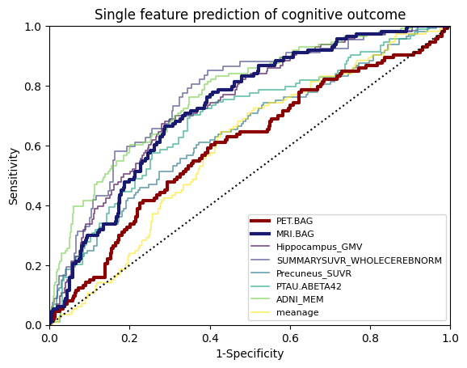
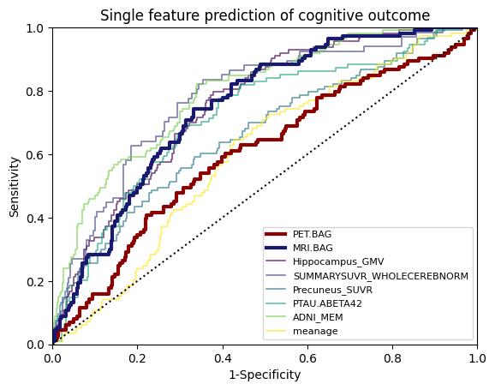
CU
n.s.
Category
Stable
Decline
CU
n.s.
Category
Stable
Decline
Density
FDG-PET BAG [years]
MRI BAG [years]
MCI
p = .002
Category
Stable
Decline
MCI
p < .001
Category
Stable
Decline
Density
FDG-PET BAG [years]
MRI BAG [years]
CU
MCI
Sensitivity
1-Specificity
1-Specificity
FDG-PET BAG
MRI BAG
Hippocampus GMV
AV45-PET
Precuneus SUVR
p-tau₁₈₁/Aβ₁₋₄₂
ADNI-MEM
age

Slide 5
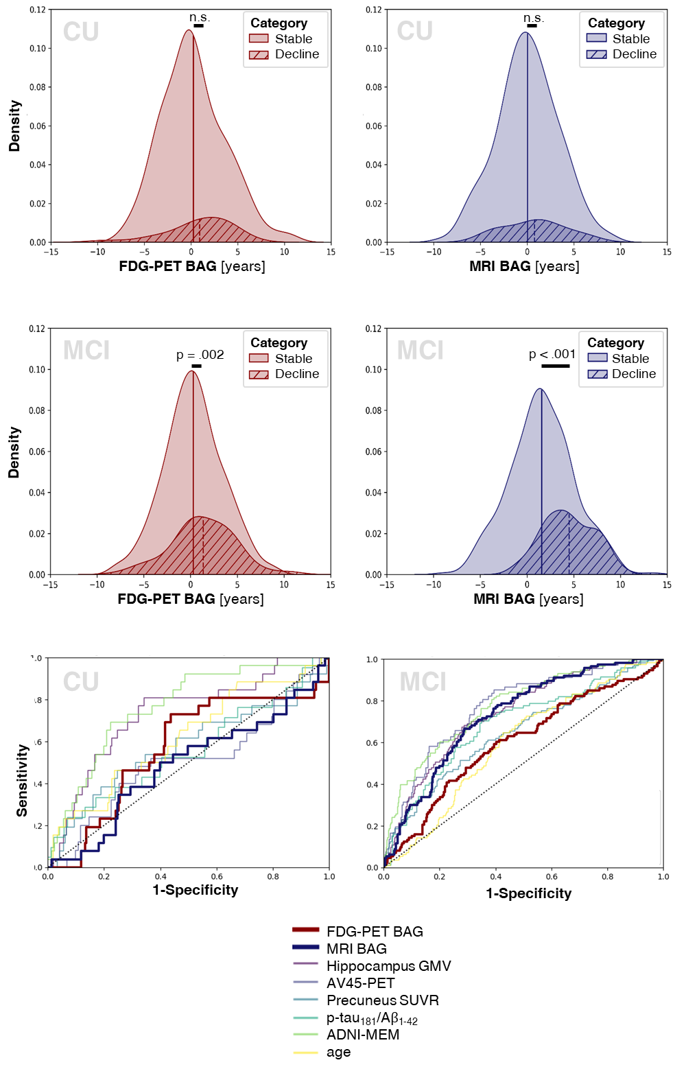
a)
b)
c)

Slide 6
Predicted Probability of Cognitive Decline [%]
a)
FDG-PET-BPAD [years]
Cognitive category
stable
decline

Slide 7
Predicted Probability of Change in Diagnosis [%]
FDG-PET BAG [years]
Cognitive outcome
stable
decline

Slide 8
Predicted Probability of Change in Diagnosis [%]
MRI BAG [years]
Cognitive outcome
stable
decline

Slide 9
Education
PET-BPAD
MRI-BPAD
APOE-e4 carrier
Aβ+
Aβ NA
Sample 1
Sample 2

Slide 10
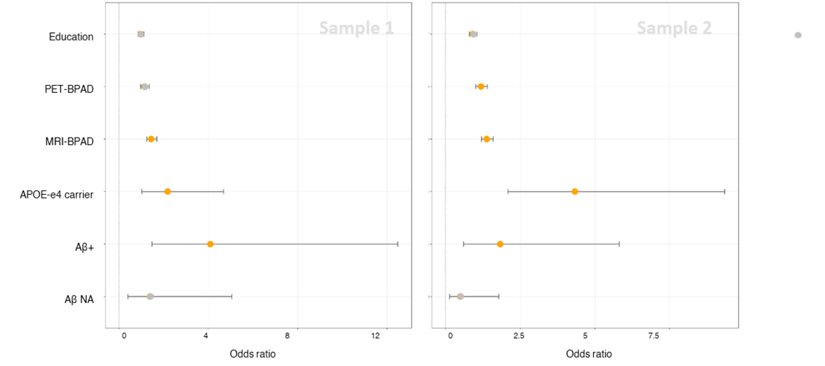
OLD

